Slide 1
Highlights from the FY24 Governmentwide Section 508 Assessment
IT Accessibility Community Meeting
GSA Government-wide IT Accessibility Team | 15 APR 2025

Slide 2
Table of Contents
Background and What’s in the Report
Analysis and Data
Key Findings and Recommendations
Next Steps

Slide 3
Background

Slide 4

Section 508 of the Rehabilitation Act
Section 508 of the Rehabilitation Act (29 USC 794d), as amended in 1998, requires information and communication technology (ICT) that is procured, developed, maintained, and used by federal agencies to be accessible and usable by:
Individuals with disabilities
Members of the public accessing government ICT
Federal employees
Section 508 tasks General Services Administration (GSA) to provide technical assistance to help federal agencies comply with Section 508 requirements and ensure covered ICT is accessible to and usable by individuals with disabilities.
Notes:
To that end, section 508 of the rehabilitation act was amended in 1998 (https://www.section508.gov/manage/laws-and-policies/section-508-law/) to require that any federal information in communication technology that is procured, developed, maintained or even used is accessible to people with disabilities, including both members of the public who access and and use government information and information technologies and federal employees who need digital tools and applications to be accessible to do their jobs on a daily basis.
Applies to all federal agencies when they develop, procure, maintain, or use electronic and information technology.
Requires that agencies must give disabled employees and members of the public access to information comparable to the access available to others.
Also called the Revised 508 Standards
Establishes the technical specifications that implement Section 508
Describes how to ensure that Section 508-covered hardware, software, and electronic content – including web and non-web content – fully conform to these technical specifications
OMB M-Memos such as M-24-08, “Strategic Plan for Improving Management of Section 508 of the Rehabilitation Act”
GSA’s Government-wide IT Accessibility Program
U.S. Access Board (USAB) to develop and promote rules around ICT accessibility

Slide 5

Overview of Reporting Mandate
In Public Law No. 117-328 (codified in 29 U.S.C. § 794d-1), Congress stipulated the Office of Management and Budget (OMB), GSA and the Access Board (USAB) would report on governmentwide accessibility. The following items were mandated:
OMB in consultation with GSA and USAB issues questions and metrics agencies must report with a spring due date.
Agencies must respond by summer due date set by OMB and GSA.
No later than (NLT) December 29 annually, GSA in consultation with OMB must provide the following:
A comprehensive assessment by agency and governmentwide, generally of compliance to accessibility standards
A detailed description of actions and efforts GSA took to support compliance at agencies over the past year and planned efforts to do the same
A list of recommendations to Congress to help support accessibility compliance
Notes:
To that end, section 508 of the rehabilitation act was amended in 1998 (https://www.section508.gov/manage/laws-and-policies/section-508-law/) to require that any federal information in communication technology that is procured, developed, maintained or even used is accessible to people with disabilities, including both members of the public who access and and use government information and information technologies and federal employees who need digital tools and applications to be accessible to do their jobs on a daily basis.
Applies to all federal agencies when they develop, procure, maintain, or use electronic and information technology.
Requires that agencies must give disabled employees and members of the public access to information comparable to the access available to others.
Also called the Revised 508 Standards
Establishes the technical specifications that implement Section 508
Describes how to ensure that Section 508-covered hardware, software, and electronic content – including web and non-web content – fully conform to these technical specifications
OMB M-Memos such as M-24-08, “Strategic Plan for Improving Management of Section 508 of the Rehabilitation Act”
GSA’s Government-wide IT Accessibility Program
U.S. Access Board (USAB) to develop and promote rules around ICT accessibility
Public Law No. 117-328: https://www.congress.gov/bill/117th-congress/house-bill/2617/text
29 U.S.C. § 794d-1: https://www.govinfo.gov/content/pkg/USCODE-2022-title29/html/USCODE-2022-title29-chap16-subchapV-sec794d-1.htm
100 days after enactment (NLT 8 April), OMB in consultation with GSA & USAB would provide questions/metrics that agencies must report on
225 Days after enactment (NLT 11 August), agencies must respond
365 days after enactment (NLT 29 December), GSA in consultation with OMB must provide the following:
A comprehensive assessment by agency and government-wide generally of compliance to accessibility standards
A detailed description of actions/efforts that GSA took to support compliance at agencies over the past year and planned efforts to do the same
A list of recommendations to Congress to help support accessibility compliance

Slide 6
Where to Find the Annual Assessment Reports
Visit: SECTION508.GOV/ASSESSMENT-REPORTS/
Assessment Reports in HTML and PDF
Assessment Data & Downloads
Reporting Entity Response Data (FY23-24)
Regression Results (FY23-24)
Data Dictionary (FY23-24)
Data Validation (FY23-24)
Pre and Post Analysis For FY24 Governmentwide Section 508 Assessment (FY24)
By Entity Pages:
FY24: SECTION508.GOV/MANAGE/SECTION-508-ASSESSMENT/2024/APPENDIX-C-OVERVIEW/
FY23: SECTION508.GOV/MANAGE/SECTION-508-ASSESSMENT/2023/APPENDIX-C-OVERVIEW/
Notes:
FY24 Assessment (HTML): section508.gov/2024-congressional-report
FY24 Assessment (PDF): https://assets.section508.gov/files/reports/cr-2024/FY24%20Governmentwide%20Section%20508%20Assessment.pdf
FY24 Entity Responses: https://assets.section508.gov/files/reports/cr-2024/Reporting%20Entity%20Response%20Data%20for%20FY24%20Governmentwide%20Section%20508%20Assessment.csv
FY24 Data Dictionary: https://assets.section508.gov/files/reports/cr-2024/Data%20Dictionary%20for%20FY24%20Governmentwide%20Section%20508%20Assessment%20Final.xlsx
By Entity Pages: www.section508.gov/manage/section-508-assessment/2024/appendix-c-overview/

Slide 7
FY24 Assessment Criteria: 103 Questions
38
38 Maturity Questions
Questions focused on assessing maturity and health of respondent accessibility; nine categories are:
IT Accessibility Program Office
Policies, Procedure, and Practices
Acquisition and Procurement
Technology Lifecycle Activities
Testing and Validation
Communications
Content Creation
Training
Human Capital, Culture and Leadership
36
36 Conformance Questions
Questions focused on specific conformance metrics for: web, hardware, software, documents, selected enterprise applications, and targeted program outcomes.
29
29 General Info Questions
Questions collecting general background information on Section 508 programs including: federal FTEs, contracting support, financials, and task organization, among others.
Notes:
In FY23, we had 105 split between 43 maturity question, 40 conformance and 22 general information.
While there is an overall reduction in question numbers, we utilized subsets of questions when possible, to increase the ability for question dependencies, to highlight the relationship between questions, and to increase clarity.
Most of the criteria remained unchanged in intent but language has been modified for clarity and answer selections have been truncated. Additional changes include:
Questions have been renumbered throughout.
All questions are required, however question dependencies apply.
“Reporting entity” is used instead of “agency”.
Frequency has been added directly to response options for clarity in never, sometimes, regularly, frequently, and almost always.
When a timeframe is needed for reporting, the reporting period has been added directly to applicable questions.
Several new criteria have been added including:
Q1 asks for the total number of total federal employees within the reporting entity
Q9 asks about other ICT test processes used within the reporting entity.
Q19-22 asks several questions to better understand the exceptions process.
Q23 asks about how contractors are assessed for capabilities related to ICT services.
Q69b and Q74b asks to explain how the percentage of fully conformant web pages was estimated.
Q79a-d asks for a deeper dive into the enterprise wide virtual meeting platform.
Additional answer choices have been added to:
Q8 due to WCAG 2.2 release.
Q11, Q27, and Q28 based on FY23 “Other” inputs.
Answer choices have been significantly revised for the following criteria:
Q30-33
Q36 (specifically answer choice d)
Q39-42
Q53-57
Q60
Q62-63
Q65
Q68 a-d and Q73 a-d have been moved to a subset of questions to ensure respondents understand that we are looking for a total amount.
Q71, Q76, Q77, and Q78 are no longer asking for the number of defects by WCAG or Section 508 requirement. Instead, respondents will select which WCAG or Section 508 requirements fail.
Q51 was moved from the General Information dimension to the Testing and Validation dimension.
Q66 was moved from the Testing and Validation dimension to the Training dimension.
To broaden the scope of inquiries regarding ICT, we have introduced 10 new questions from Q80 to Q89, replacing the previous FY23 criteria for Q82-85 and Q87-92. These questions will be rotated on a biennial basis. Anticipate the reintroduction of FY23 criteria for FY25, providing reporting entities time to address identified issues, with the aim of achieving higher conformance by FY25. Additionally, we have revised the answer options in this section. Instead of a simple binary choice regarding Section 508 conformance, respondents are now presented with a scale of conformance, allowing for a more nuanced understanding of the extent of defects.
Q103 has been modified to ask specific questions for the entities to respond to. It remains a free form text field.
Five questions have been removed altogether: one from Training, one from Content Creation, one from Policies, Procedures, and Practices, a question in Conformance Metrics regarding a public feedback mechanism, and the criteria regarding defects for enterprise-wide printers due to because of duplicative data, incorrectly scoped questions, or poor data.

Slide 8
What’s in the Report?
The report has a similar look and feel to the FY23 Assessment, with several key enhancements:
Introduction of year-over-year (YOY) comparisons
Refinement of the by-entity pages to visualize those YOY changes
Exploration of potential drivers of change or lack thereof
Includes FY23 Assessment recommendations and M-24-08 as potential interventions
The report continues to include analysis of how the government as a whole is performing, conformance data of top ICT, dimensional and category-level analysis and recommendations, recommendations to Congress and agencies, and actions taken by GSA this year as well as those planned for next year to improve agency conformance.
Notes:
We had 249 entities report last year, 245 this year. YOY we had 230 of the same entities report. This year we had 15 new people. Several folks restructured, one entity closed, and 6 folks just did not submit.
Link to FY23 Assessment: https://assets.section508.gov/files/reports/cr-2023/FY%2023%20Governmentwide%20Section%20508%20Assessment%20Report.pdf
Technically uses “reporting entity” as the unit of data collection, with FY24 including submissions from 245 reporting entities:
24 Chief Financial Officers (CFO) Act Agencies - the biggest agencies in the federal government (11 of which act as “Parents” of 158 components)
63 small and independent agencies or entities (e.g., Commissions, Councils, Corporations)

Slide 9
Understanding Terms
The Assessment:
Defines “agency” as any federal department, component-level, and independent agency subject to Section 508 of the Rehabilitation Act.
Agency components, such as bureaus, subagencies, and major organizational divisions, as determined by the agency, reported independently from their parent agencies.
Parent agencies limited their reporting to their own operations, excluding input from component agencies.
Assessment instructions stated parent agencies should coordinate with their components to enhance the accuracy and consistency of responses.
Technically uses “reporting entity” as the unit of data collection, with FY24 including submissions from 245 reporting entities:
24 Chief Financial Officers (CFO) Act Agencies - the biggest agencies in the federal government (11 of which act as “Parents” of 158 components)
63 small and independent agencies or entities (e.g., Commissions, Councils, Corporations)
Notes:
As noted in 2.4 Chief Financial Officers Act (1990) | CIO.GOV:
The CFO Act gave OMB new authority for federal financial management, modernizing systems, and strengthening reporting.
When we say CFO Act agencies, we understand it as shorthand for the biggest federal agencies.

Slide 10
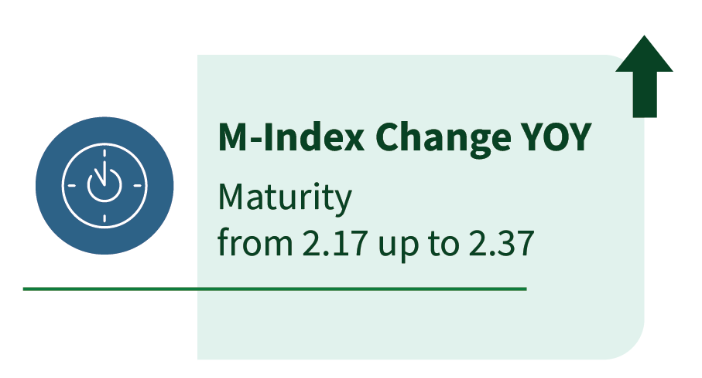
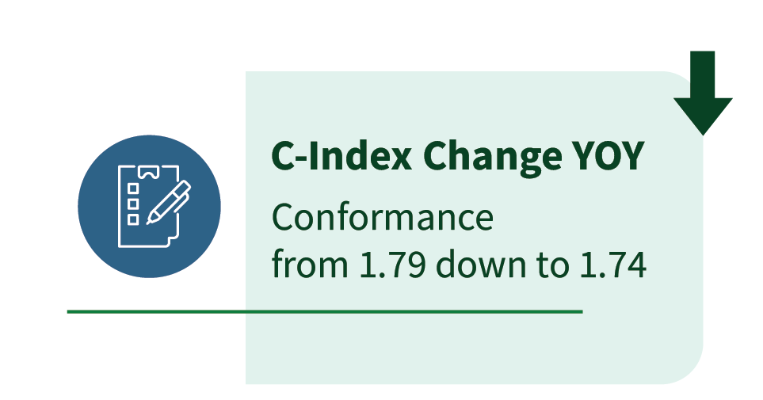
Executive Summary
Responses from 245 entities of varying size and mission demonstrated:
Conformance did not improve, dropping YOY from 1.79 to 1.74, remaining Low
On average, governmentwide maturity stayed Moderate, with only a slight improvement to 2.37 from 2.17 on 5-point scale
Persistent gaps in conformance of top viewed ICT and frequently used ICT
Increased investments in training were reported
Reporting shows an improvement in prioritization of digital accessibility needs
Progress shown in technology lifecycle activities and Section 508 testing
Incremental progress in Section 508 Program staffing
Procurement issues persist
Notes:
We had 249 entities report last year, 245 this year. YOY we had 230 of the same entities report. This year we had 15 new people. Several folks restructured, one entity closed, and 6 folks just did not submit.
On average, governmentwide maturity slightly improved to 2.37 on a 5-point Maturity Index, up from 2.17 in FY23. However, conformance did not improve, dropping YOY from 1.79 to 1.74 on the Conformance Index, remaining Low. More than 60% of respondents reported no change in conformance across their most-viewed ICT content. Insufficient staffing and resources remain barriers, limiting the reporting entity’s ability to test, remediate, and enforce accountability effectively. Other highlighted findings include:
Maturity Improvements YOY: 27% of entities reported High maturity in FY24, up from 14% in FY23; 6% reported Very High maturity in FY24, up from 4% in FY23.
Persistent Conformance Gaps: About one-third or less of entities’ top-viewed ICT is fully conformant:
23% of public internet pages
20% of intranet pages
25% of public documents
34% of videos
Frequently Used ICT Remains Inaccessible: Less than half of entities reported full conformance of ICT products commonly used by federal employees and the public,
Limited Testing Capacity: Approximately half of the reporting entities lacked resources to test their top-viewed ICT content.
Increased Investments in Training: Training was the lowest dimension last year and remains the second lowest this year, but entities noted substantial investments in training, resulting in a 31% improvement in the average Training maturity outcomes across government.
Prioritization of Digital Accessibility Needs Improvement: Human Capital, Culture, and Leadership is the lowest dimension in FY24 and was the second lowest in FY23. Entities are making improvements including Section 508 compliance in leadership and management performance plans and integrating skills and competencies into relevant roles and responsibilities, which resulted in an improvement of about 18% in this dimension across the government. While improvements were reported, digital accessibility remains deprioritized.
Progress in Technology Lifecycle Activities and Section 508 Testing: Overall, Section 508 testing and Section 508 integration into the technology lifecycle improved over the past year. The majority of reporting entities use a combination of automated and manual tools to test comprehensively, with a notable increase in the use of manual testing methods. Entities are increasingly conducting testing on web content and integrating Section 508 reviews into electronic content prior to publication. However, inadequate or absent consideration of Section 508 at the early stages of the ICT lifecycle remains a significant challenge with 41% of respondents reporting that they sometimes or never integrate Section 508 conformance into technology lifecycle activities, or are unsure how often it occurs.
Incremental Progress in Section 508 Program Staffing: The percentage of reporting entities with a full-time Section 508 PM increased to 33%, up from 28% last year, and the average weekly hours dedicated to Section 508 activities rose to 17.9—reflecting a 16.2% YOY increase. While 21% more entities now have a Section 508 PM than in FY23, 11% still do not. Despite these gains, many programs continue to lack sufficient staffing to fully meet digital accessibility requirements.

Slide 11
Analysis and Data

Slide 12
Analysis Process: Indexing
The team assessed responses to the criteria across each reporting entity and broke them down into business function maturity and operational conformance, which were aligned to a Likert scale that ranged from Very Low to Very High.
Business Function Maturity Index: Includes responses to criteria across nine dimensions with equal weighting of each criteria.
Operational Conformance Index: Quantified 16 specific criteria, or questions, in the Conformance section of question to assess how well entities performed with respect to Section 508 implementation.
Overall Performance: When combined, both indices above provided a reporting entities’ overall performance category that, given the scales, ranged from Very Low-Very Low to Very High-Very High.
Maturity and Conformance Brackets
Bracket | Value Range
Very High | >4 to 5
High | > 3 to 4
Moderate | >2 to 3
Low | >1 to 2
Very Low | 0 to 1

Slide 13
Analysis Results: Maturity and Conformance Brackets
Similar to FY23, a majority of reporting entities fall in the bottom nine categories — those that fell in any combination of Very Low, Low, and Moderate for both maturity and conformance, i.e., the bottom left of the table below. However, about 61% of reporting entities, or 151 entities, fell in these categories, whereas roughly 76% of reporting entities fell in these nine lower categories in FY23.
Very High Conformance | 0 | 0 | 2 | 6 | 5
High Conformance | 0 | 4 | 9 | 11 | 4
Moderate Conformance | 2 | 8 | 16 | 14 | 2
Low Conformance | 7 | 15 | 36 | 24 | 3
Very Low Conformance | 20 | 34 | 13 | 10 | 0
 | Very Low Maturity | Low Maturity | Moderate Maturity | High Maturity | Very High Maturity
Notes:
Of the 230 reporting entities that reported both years, data shows:
86 entities improved in both indices YoY.
53 entities declined in both indices YoY.
61 entities improved in m-index but declined in c-index.
29 entities declined in m-index but improved in c-index.
M-Index Improvement YoY: 148 entities
M-Index Decline YoY: 82
M-Index No Change YoY : 0
C-Index Improvement YoY: 115
C-Index Decline YoY: 114
C-Index No Change YoY: 1
Most represent incremental change, though some are more significant at 0.5 or more on a 5-point scale.

Slide 14
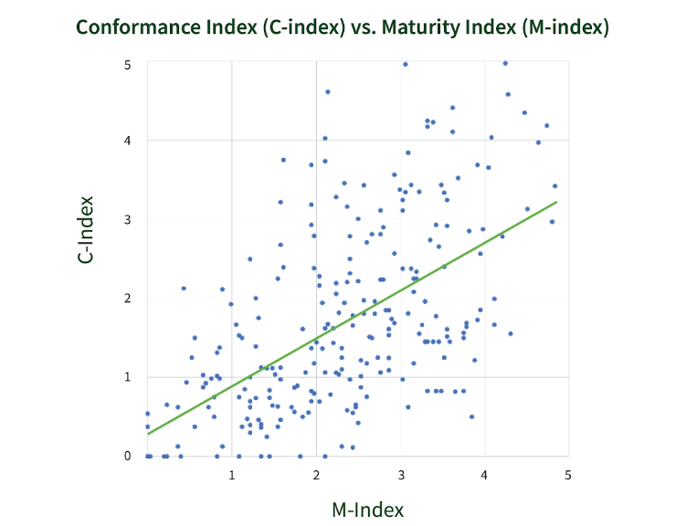
Analysis Results: Scatter Plot
For a different, more detailed view, the scatter plot shows exactly where reporting entities fell with respect to maturity and conformance.
There remains a wide reach of performance on both the maturity and conformance indexes across government.
However, more mature reporting entities tended to have higher conformance rates, and vice versa.

Slide 15
Key Findings

Slide 16
Findings at a Glance
Conformance
Maturity
What Improved: Top Viewed ICT Results
What Declined:
Overall Conformance
Testing Coverage
Intranet Conformance
Potential Drivers:
Decrease in compliance across public-facing and internal ICT
Insufficient testing resources
Shift in testing focus to be more automated, less manual
What Improved: Overall Maturity and seven Dimensions
What Declined:
Policies, Procedures, and Practices
Technology Lifecycle Activities
Potential Drivers:
Increased Investment in Section 508 program activities
Additional resources and increase in Section 508 Program Managers (PM) and time spent supporting program

Slide 17

Routine ICT Testing Declined
Testing Coverage: Fewer respondents conducted web testing as part of regular business functions:
70% assessed public internet websites, down from 78%, covering just 41% of total public pages compared to 52% last year.
Intranet web page testing also declined, with only 41% of entities testing 8% of total intranet pages, down from 26% coverage last year.
Intranet Conformance Declined: While conformance rates for public sites held steady around 62%, intranet conformance declined from 59% to 52%.

Slide 18
Testing Recommendations
Target Accessibility of High-Use Software: Congress may continue to consider conducting oversight efforts of major ICT providers to the federal government to determine how to improve accessibility of high-use products. Key ICT used both by federal government employees and the public do not fully conform to the Section 508 standards. As agencies universally use office productivity applications, survey tools, and other mainstream IT products, promoting standard Section 508-conformant solutions would enhance ICT accessibility throughout the government.
Increase Conformance Validation Testing and Remediation: The average conformance continues to be under 2.0 on a 5-point conformance index scale and 50% or more respondents said they did not have resources to test their ICT. Agencies should increase automated and manual Section 508 conformance testing, validation, and defect remediation before deployment, which will likely create substantial positive downstream impacts as more conformant products and services are deployed.
Adopt the Baselines for Web and Electronic Documents: As testing methodologies and outcomes have been reported to be inconsistent, agencies are encouraged to use the Section 508 ICT Testing Baselines for Web and Electronic Documents to create baseline-aligned test processes.
Notes:
Incorporating the baseline tests into a test process ensures necessary elements are tested, reducing the risk of overlooking important requirements. The baseline provides clear guidance on what needs to be tested, helping organizations assess the accuracy of their testing methodology and tools.

Slide 19
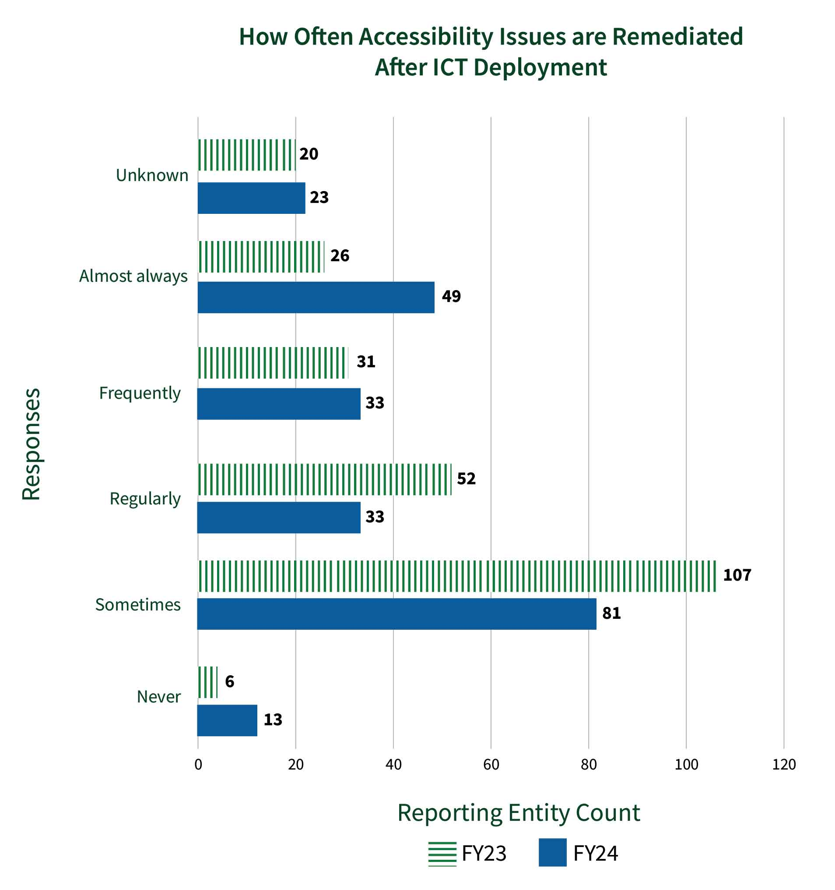
Technology Lifecycle Key Findings
Improved Remediation Rates: 52% of entities reported regularly, frequently, or almost always tracking and remediating digital content.
High-Severity Issue Response: 20% of entities almost always immediately remediate high-severity issues, an 88% increase from FY23.
Future Investments: Reporting entities are investing in remediation efforts, which may lead to better conformance outcomes in future years.
Notes:
In FY24, the majority of respondents or 52% reported regularly, frequently, or almost always track and remediate digital content, whereas last year, the majority or 51% did not.

Slide 20
Technology Lifecycle Recommendation
Incorporate Section 508 Throughout the Technology Lifecycle: Given that 63% of respondents do not assess risk of Section 508 nonconformant ICT throughout the technology development lifecycle, agencies should incorporate digital accessibility considerations into relevant internal control processes to better ensure accessibility throughout the technology lifecycle.
As an example, the Environmental Protection Agency (EPA) and the Department of Veterans Affairs (VA) include Section 508 compliance as part of the Authority To Operate (ATO) certification process, underscoring the significance of creating and maintaining secure and accessible applications.

Slide 21
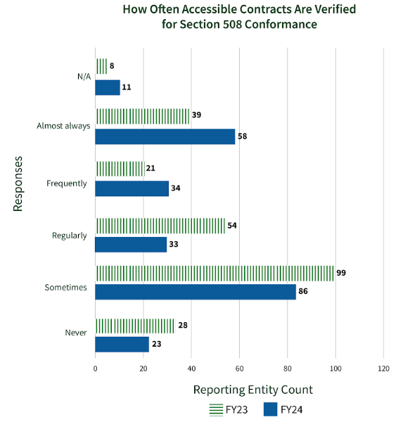
Acquisition Key Findings
Though slightly improved from FY24, 46.6% of entities still accept contract deliverables without confirming they meet digital accessibility requirements.
12 entities or 8% reported no ICT solicitations included all applicable Section 508 requirements.
46% of respondents regularly, frequently, or almost always include Section 508 in the technical evaluation of ICT-related proposals.
50% of respondents regularly, frequently, or almost always obtain ACRs for all products and consideration for Section 508 conformance is a formal part of review during the market research phase for ICT products.
Notes:
Despite the improvement, over a quarter of reporting entities continue to report they do not know if their ICT solicitations include all applicable requirements.

Slide 22
Acquisition Recommendation
Require Section 508 as a Major Factor in Acquisition: As many respondents still do not consistently include Section 508 requirements in solicitations, Chief Acquisition Officers, CIOs, and Heads of Agencies should:
Develop and implement policies that integrate ICT accessibility into all ICT acquisition activities.
Include Section 508 conformance as a major or technical factor during the award or decision-making process, as appropriate.
Reject contract deliverables unless they meet Section 508 requirements, as required by the contract.

Slide 23

Training Key Findings
Mandatory Section 508 training by roles and responsibilities substantially increased YOY, with all roles and responsibilities noting an increase in mandatory Section 508 training.
In FY24, 34% of entities implemented a mandatory Section 508 training for all employees, up from 22% in FY23, with the majority of those requiring training on a regular basis, leading to a 55% increase YOY.
In FY24, 37% of respondents or 91 entities said they have no Section 508 training plan defined compared to 44% in FY23, showing improvement YOY.
Notes:
Last year, 44% of entities lacked any Section 508 training plan. In FY24, this number decreased by 16%

Slide 24
Training Recommendation
Require Annual Section 508 Training by Roles and Responsibilities: Although a significant improvement from last year, only about 34% of entities reported requiring any Section 508 training for employees. Additionally, 37% of respondents have no Section 508 training plan defined. Agencies should require annual Section 508 training for all employees who create, maintain, or otherwise contribute to the agencies’ digital content. In addition:
It is recommended the following online training courses or equivalent be required to achieve Contracting Officer's Representative (COR) Certification:
Micro-Purchases and Section 508 Requirements (FAC 047)
Soliciting and Evaluating Accessibility Conformance Reports in Federal ICT Procurement (FAC 049)
Procuring Section 508 Conformant ICT Products and Services (FAC 056)
As only 18% of respondents require Section 508 training for developers and 26% of respondents require Section 508 training for web content managers, agencies are encouraged to require training for all ICT testers on agency testing methodologies.

Slide 25
Next Steps

Slide 26


Next Steps
Release Assessment Criteria and Reporting Tool in the spring
Receive Submissions and Analyze FY25 Data in the summer

Slide 27
Resources and Contact Information
Visit: SECTION508.GOV/ASSESSMENT-REPORTS/
Assessment Reports in HTML and PDF
Assessment Data & Downloads
By Entity Pages:
FY24: SECTION508.GOV/MANAGE/SECTION-508-ASSESSMENT/2024/APPENDIX-C-OVERVIEW/
FY23: SECTION508.GOV/MANAGE/SECTION-508-ASSESSMENT/2023/APPENDIX-C-OVERVIEW/
FY25 Criteria (Spring): SECTION508.GOV/SECTION-508-ASSESSMENT/
Contact our team at Section.508@gsa.gov
Notes:
FY24 Assessment (HTML): section508.gov/2024-congressional-report
FY24 Assessment (PDF): https://assets.section508.gov/files/reports/cr-2024/FY24%20Governmentwide%20Section%20508%20Assessment.pdf
FY24 Entity Responses: https://assets.section508.gov/files/reports/cr-2024/Reporting%20Entity%20Response%20Data%20for%20FY24%20Governmentwide%20Section%20508%20Assessment.csv
FY24 Data Dictionary: https://assets.section508.gov/files/reports/cr-2024/Data%20Dictionary%20for%20FY24%20Governmentwide%20Section%20508%20Assessment%20Final.xlsx
By Entity Pages: www.section508.gov/manage/section-508-assessment/2024/appendix-c-overview/

Slide 28
Let’s take a 10-minute break!

Slide 29
Backups

Slide 30



About Us: The GSA Government-wide IT Accessibility Program
Host Section508.gov and assist with technical support, guidance, and advice to agencies and individuals with questions and issues relating to the implementation of Section 508 requirements.
Focus on providing support to federal agencies in the following primary areas:
Accessible Acquisition
Policy and Program Management
Content Creation
Accessible Design and Development
Accessibility Testing
Accessibility Training and Events
Conduct the Congressionally-mandated, annual Governmentwide Section 508 Assessment.
Notes:
Refined Assessment criteria, FAQs, and definitions to collect more accurate data from agencies.
Created key performance indicators (KPIs) to help agencies create measurable targets for improving their Section 508 maturity and conformance outcomes.
Regularly improved Section508.gov to help agencies incorporate accessibility into mission and IT-lifecycle activities.
Led regular, recurring governmentwide meetings for collaboration, training and knowledge sharing.
Enhanced two main accessibility requirements acquisition tools: the Solicitations Review Tool (SRT) and the Accessibility Requirements Tool (ART).
ACR Repository and ACR Editor

Slide 31
Where to Find the FY24 Assessment Report
FY24 Assessment (HTML): section508.gov/2024-congressional-report
FY24 Assessment (PDF): https://assets.section508.gov/files/reports/cr-2024/FY24%20Governmentwide%20Section%20508%20Assessment.pdf
FY24 Entity Responses: https://assets.section508.gov/files/reports/cr-2024/Reporting%20Entity%20Response%20Data%20for%20FY24%20Governmentwide%20Section%20508%20Assessment.csv
FY24 Data Dictionary: https://assets.section508.gov/files/reports/cr-2024/Data%20Dictionary%20for%20FY24%20Governmentwide%20Section%20508%20Assessment%20Final.xlsx
By Entity Pages: www.section508.gov/manage/section-508-assessment/2024/appendix-c-overview/
Notes:
FY24 Assessment (HTML): section508.gov/2024-congressional-report
FY24 Assessment (PDF): https://assets.section508.gov/files/reports/cr-2024/FY24%20Governmentwide%20Section%20508%20Assessment.pdf
FY24 Entity Responses: https://assets.section508.gov/files/reports/cr-2024/Reporting%20Entity%20Response%20Data%20for%20FY24%20Governmentwide%20Section%20508%20Assessment.csv
FY24 Data Dictionary: https://assets.section508.gov/files/reports/cr-2024/Data%20Dictionary%20for%20FY24%20Governmentwide%20Section%20508%20Assessment%20Final.xlsx
By Entity Pages: www.section508.gov/manage/section-508-assessment/2024/appendix-c-overview/

Slide 32
Analysis Methods
The Assessment team analyzed the self-reported data using several methodologies:
Indexing Analysis: Assessed all entities on a ranged scale to compare against an ideal state of accessibility conformance
Overall Performance Group Statistics: Analysis using Likert-like scales to bin entities to create like groups called categories
Descriptive Statistics by Question: Analysis of governmentwide outcomes by Assessment criteria
3
1
2
Pre and Post Analysis: Statistically significant changes YOY
4
Notes:
Regressions were run this year but nothing was noted as significant. We posted those results but did not include any in the report.

Slide 33
Analysis Results: Maturity Dimensions
In FY23, the two lowest performing dimensions governmentwide were the Human Capital, Culture, and Leadership dimension and the Training dimension. For FY24, they are the same but switched places.
The highest performing dimension was Content Creation followed by Communications and the IT Accessibility Program.
Seven maturity dimensions increased and two decreased YOY.
Dimension | Average FY24 Federal Outcome | Average FY23 Federal Outcome
IT Accessibility Program Office | 2.55 | 2.27
Policies, Procedures, and Practices | 2.35 | 2.54
Communications | 2.63 | 2.10
Content Creation | 2.69 | 2.34
Human Capital, Culture, and Leadership | 1.93 | 1.63
Technology Lifecycle Activities | 2.38 | 2.57
Testing and Validation | 2.38 | 2.04
Acquisition and Procurement | 2.53 | 2.44
Training | 2.06 | 1.57
Notes:
The maturity section of the criteria included 38 questions broken down into 9 dimensions:
IT Accessibility Program Office; Policies, Procedures, and Standards; Communications; Content Creation; Human Capital, Culture, and Leadership; Technology Lifecycle Activities, Testing and Validation; Acquisition and Procurement; and Training
Last year Training was the lowest Dimension at 1.57 with Human Capital, Culture and Leadership at 1.63. In 2024, these scores are 2.06 and 1.93, respectively. This represents a 31% improvement in the average Training maturity outcomes across government. Human Capital also saw an improvement of about 18% across the government.
Overall, approximately 28% of entities (68) had Human Capital, Culture and Leadership as their worst dimension (or one of their worst), and 63 (or approximately 26%) had Training as their worst dimension. So, while these dimensions saw an improvement year over year, they are still the areas of most needed development or investment going forward to improve average reporting entity maturity outcomes.

Slide 34
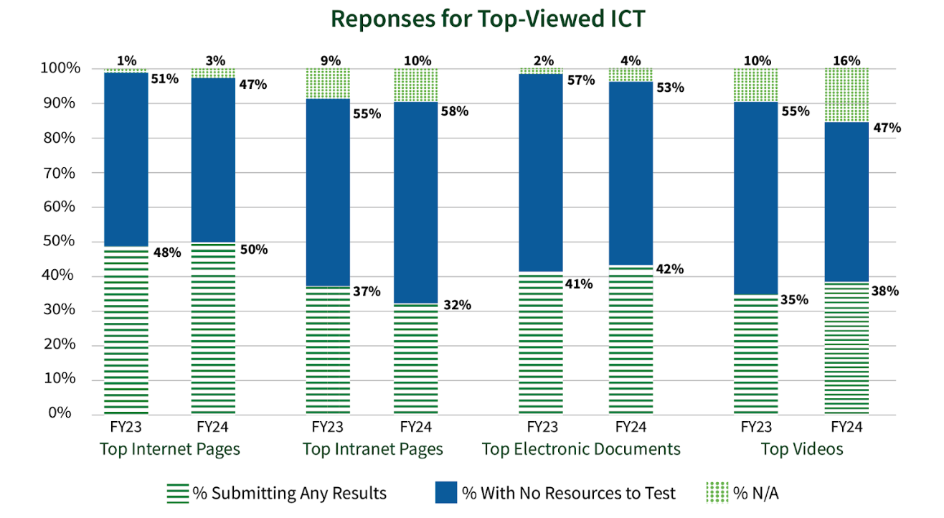
Resourcing to Test ICT Is Still Lacking
Top Viewed ICT Results:
Slightly more entities submitted results this year for top viewed internet web pages, documents, and videos.
14% fewer entities provided results for top viewed intranet web pages.
Lack of resourcing to test remains a persistent issue.

Slide 35
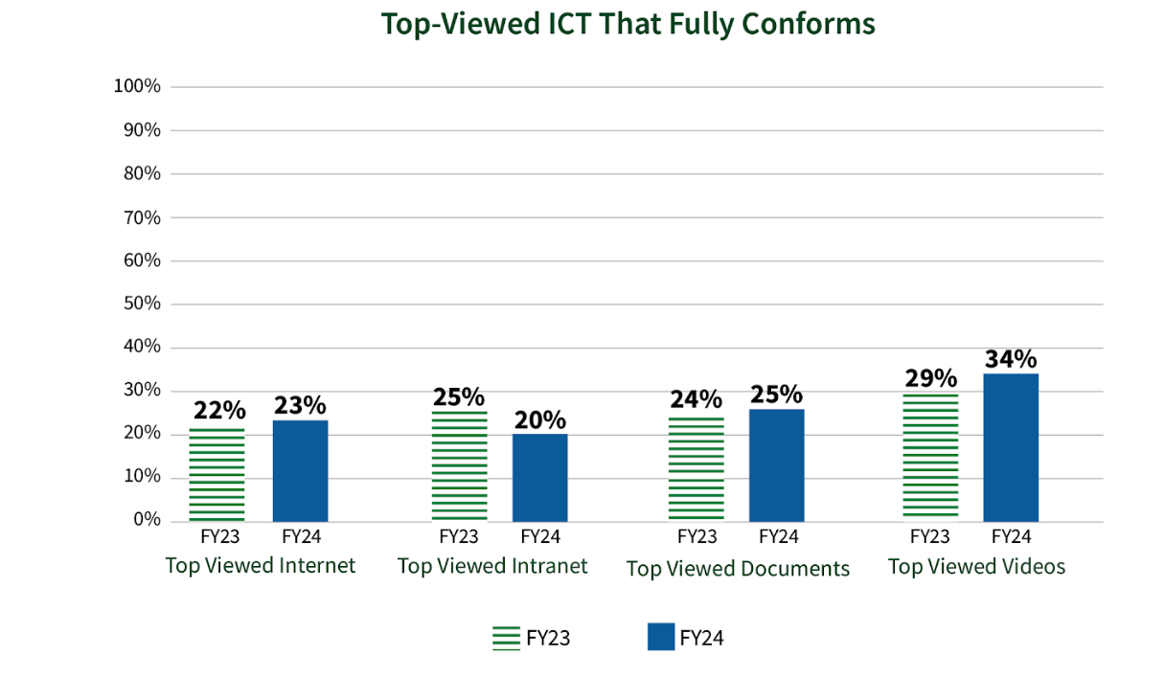
Conformance of Top Viewed ICT Remains Low
Despite slight improvement, governmentwide Section 508 compliance for the top viewed ICT remains low, with approximately less than one-third of all top viewed ICT reporting as fully conformant.
Trends point to overall stagnation: 115 entities improved in conformance; 114 declined.

Slide 36
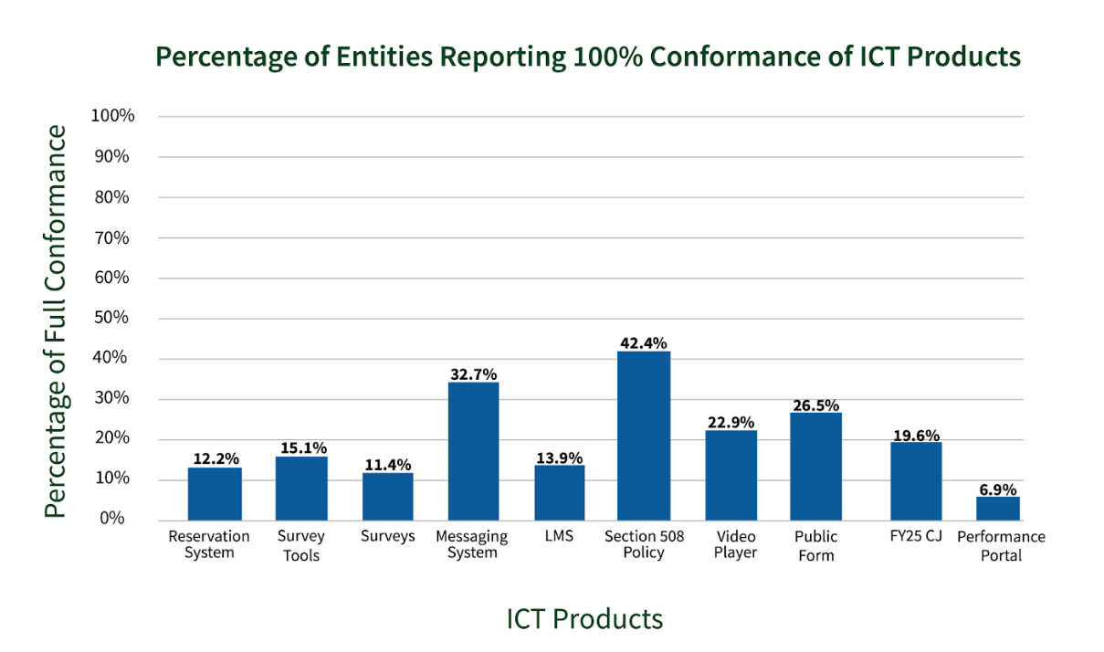
Common ICT Is Not Fully Accessible
Most accessible product is the entity Section 508 or ICT Policy, followed by the chat or messaging system.
Least accessible is the employee performance portal or equivalent, followed by surveys produced by the entity.
Notes:
Examining entities that reported 90% or more conformance for ICT products, including those who reported 100% conformance, shows an increase in the number of entities who conform to most, but not all, Section 508 standards. This suggests that while the ICT products may still have some accessibility issues, they may be close to fully conformant. The highest conformance percentage was still the publicly posted Section 508 policy at 61.2% of entities who conform to 90% or more of the standards followed closely again by enterprise-wide chat or real-time messaging system at 60.8% of entities. However, the lowest percentage of conformance was surveys released by entities, with only 27.8% of reporting entities noting conformance with 90% or more of standards.

Slide 37
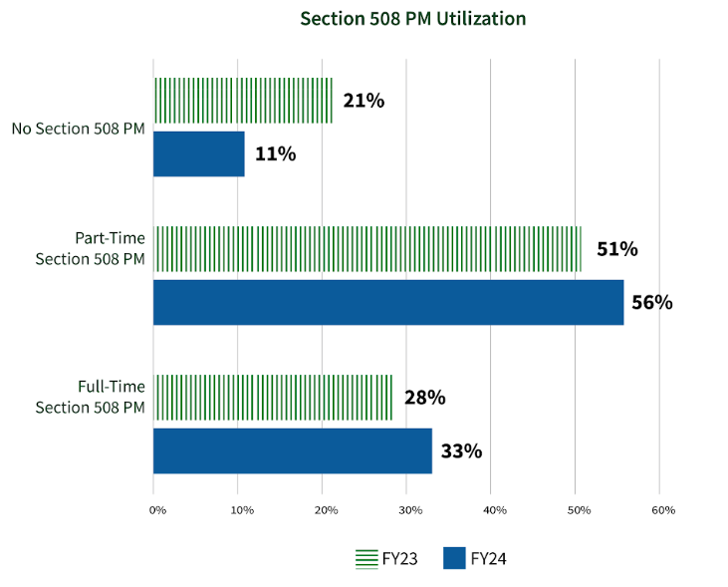
Section 508 Resourcing
Full time Section 508 PMs increased to 33%, up from 28% last year.
The average weekly hours dedicated to Section 508 activities rose to 17.9—reflecting a small YOY increase.
Slightly more Section 508 FTEs were reported this year:
Average of 5.5 FTEs, up from 4.3 in FY23, comprising an average of 3.7 federal and 1.8 contractor Section 508 FTEs.
Despite these gains, many programs continue to lack sufficient staffing to fully meet digital accessibility requirements.
Notes:
In FY24, 75 reporting entities reported less than one Section 508 FTE (a 19% decrease since FY23), with only 19 entities reporting no FTEs (a 47% decrease since FY23).
Average of 5.5 FTEs (up from 4.3 in FY23), comprising an average of 3.7 federal (2.7 in FY23) and 1.8 contractor (1.6 in FY23) Section 508 FTEs.

Slide 38
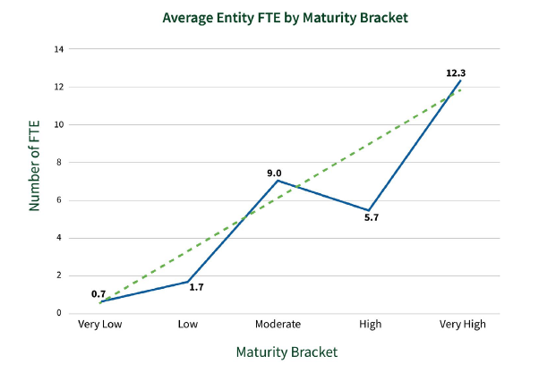
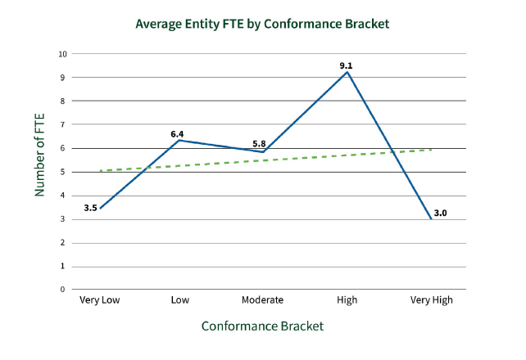
Average FTEs by Bracket
There is a positive correlation between the total number of FTEs and maturity and conformance outcomes. Better resourced organizations tend to be more mature and more conformant.

Slide 39
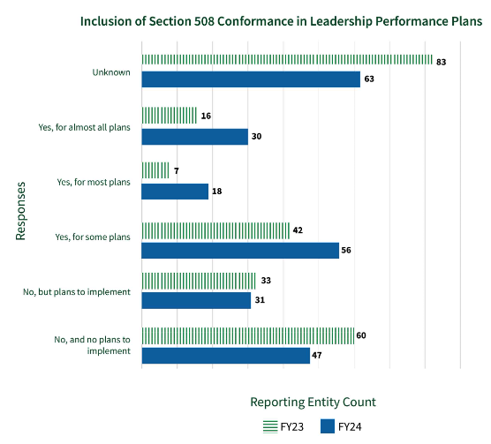
Competencies and Leadership Key Findings
Data shows a 60% increase YOY in the number of entities who indicated they include Section 508 conformance in ICT-related leadership and management performance plans.
13.5% of respondents in FY24 selected they do not integrate ICT accessibility into professional development plans compared to 63% in FY23.
40% of entities responded that staff who are involved in technology development lifecycle activities either sometimes or never have sufficient knowledge and skill to ensure ICT is Section 508 conformant, compared to 50% in FY23.

Slide 40

Resourcing and Leadership Recommendations
Ensure Sufficient Section 508 Program Resourcing: Since additional funding to aid Section 508 implementation was selected as a key factor for helping implement digital accessibility, agency Chief Information Officers (CIO) or equivalent should consider appropriately resourcing their Section 508 programs to ensure Section 508 program resourcing is explicitly included in budget requests.
Invest in Human Capital, Culture, and Leadership Efforts: For 141 entities, or approximately 58%, either the accessibility performance metrics are unknown or there are no such metrics in leadership performance plans and no current intent to include them. Agencies should develop accessibility-related metrics to include in annual leadership performance plans. Increasing accountability may increase prioritization of digital accessibility, likely improving conformance of ICT.

Slide 41
Observations
New and Missing Entities: This year, 15 new entities submitted data, while 19 entities from last year did not due to closures, restructuring, or lack of submission.
Feedback and Improvements: Entities provided feedback through various channels, leading to clearer Assessment questions and better response options for this year.
Data Access Challenges: Some entities struggled to gather required data due to internal silos, prompting them to create internal guides and resources.
Increased Focus on Accessibility: The Assessment process has helped agencies prioritize Section 508 programs, highlighting the need for better talent and knowledge in digital accessibility.
Data Validation Challenges: Many entities had data validation errors, indicating misunderstandings or inconsistencies in their submissions, which GSA is working to address with improved tools and support.

Slide 42
Resources and Contact Information
Read the FY24 Assessment (HTML): section508.gov/2024-congressional-report
FY24 Entity Responses: assets.section508.gov/files/reports/cr-2024/Reporting%20Entity%20Response%20Data%20for%20FY24%20Governmentwide%20Section%20508%20Assessment.csv
FY24 Data Dictionary: assets.section508.gov/files/reports/cr-2024/Data%20Dictionary%20for%20FY24%20Governmentwide%20Section%20508%20Assessment%20Final.xlsx
By Entity Pages: section508.gov/manage/section-508-assessment/2024/appendix-c-overview/
Contact Us at section.508@gsa.gov
Notes:
Read the FY24 Assessment (HTML): https://section508.gov/2024-congressional-report
FY24 Entity Responses: https://assets.section508.gov/files/reports/cr-2024/Reporting%20Entity%20Response%20Data%20for%20FY24%20Governmentwide%20Section%20508%20Assessment.csv
FY24 Data Dictionary: https://assets.section508.gov/files/reports/cr-2024/Data%20Dictionary%20for%20FY24%20Governmentwide%20Section%20508%20Assessment%20Final.xlsx
By Entity Pages: www.section508.gov/manage/section-508-assessment/2024/appendix-c-overview/
Contact Us at section.508@gsa.gov

Slide 43
Additional Recommendations to Congress
Congress should consider updating Section 508 of the Rehabilitation Act (29 U.S.C. 794(d) - Electronic and Information Technology) and 29 U.S.C. § 794d-1 to include:
Definition of Agencies Subject to Section 508 to clearly define who should follow Section 508 standards and respond to this Assessment.
Updated Language, Terminology, and Scope to harmonize and strengthen the language for applicability to the current and future digital landscape.
Strengthen Enforcement of Section 508 Compliance: Congress should explore options to strengthen enforcement of Section 508 compliance across the federal government. As shown throughout, overall Section 508 compliance is low. Enforcement through internal audits and accountability mechanisms would lead to overall improved Section 508 compliance.

Slide 44

Questions?

